Slide 1

Charles Aznavour
Charles Aznavour

Slide 2
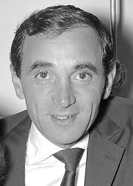
The Basics (The "ID Card")
Full Name: Shahnour Vaghinag Aznavourian.
Born: May 22, 1924, in Paris, France.
Died: October 1, 2018 (aged 94) in Mouriès, France.
Heritage: His parents were Armenian immigrants who fled to France to escape the Genocide.
Family Business: His father was a singer and his mother was an actress. Art was in his blood!

Slide 3
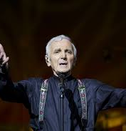
The Hard Road to Success
The Critics' Opinion: They said he was too short, his voice was too raspy, and he wasn't "handsome enough."
The Mentor: In 1946, he met Edith Piaf. She took him on tour and taught him how to dominate the stage.
The Breakthrough: In 1954, his performance at the "Olympia" in Paris made him a superstar overnight.

Slide 4
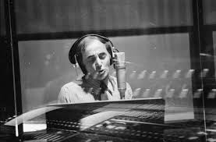
A Man of Many Talents
The Songwriter: Wrote over 1,200 songs.
The Actor: Starred in 80 movies (e.g., Shoot the Piano Player).
The Polyglot: He sang in 9 languages, including French, English, Spanish, and Russian.
Signature Songs: She, La Bohème, Une vie d'amour.

Slide 5
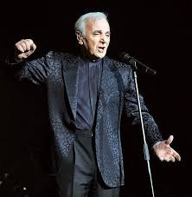
Hero of Armenia
1988 Earthquake: After the tragedy in Spitak, he dedicated his life to helping Armenia.
Charity: Founded "Aznavour for Armenia."
Diplomacy: Served as Armenia's Ambassador to Switzerland and UNESCO.
Quote: "I am 100% French and 100% Armenian."

Slide 6
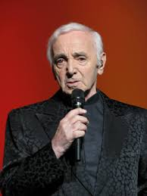
Three Iconic Songs
"She" – A Global Hit
This is one of his most famous songs worldwide. It reached Number 1 in the UK charts. It is a beautiful song about the many faces of a woman. It was also the main theme for the famous movie Notting Hill.
"La Bohème" – The Signature Song
This is Aznavour’s "musical ID card." It tells the story of young, struggling artists living in Montmartre, Paris. They were poor, but they were happy and full of dreams. When he performed it, he often used a white handkerchief as a prop.
"Une vie d'amour" – Eternal Love
In Russia and Eastern Europe, this song is legendary as "Vechnaya Lyubov." He wrote it for the movie Teheran-43. It is a powerful anthem about a love that lasts forever, even through war and time.

Slide 7
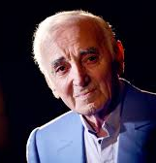
Incredible Legacy
Awards: Named "Entertainer of the Century" by CNN/Time (1998).
Longevity: Performed until the age of 94.
Sales: Sold over 180 million records worldwide.
Death: Passed away on October 1, 2018. France gave him a National State Funeral.

Slide 8
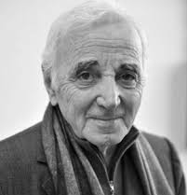
Conclusion
Charles Aznavour taught us that passion and hard work are more important than "perfect" looks or a "perfect" voice.

